Slide 1

D.R.E.A.D.
Systems Analysis

Slide 2

About 513 Studios
Based in Coeur d’Alene, ID
Quality Assurance Manager
Dan Blanchette
IT Manager
Jordan Reed
Software Architect
Taylor Martin
All other management roles
Filled as needed

Slide 3

About D.R.E.A.D.
Destroy Ravenous Extraterrestrials And Depart

Slide 4
The Goal of 513 Studios
Our goal at 513 Studios is to provide a quality product while maintaining its affordability for the consumer.

Slide 5
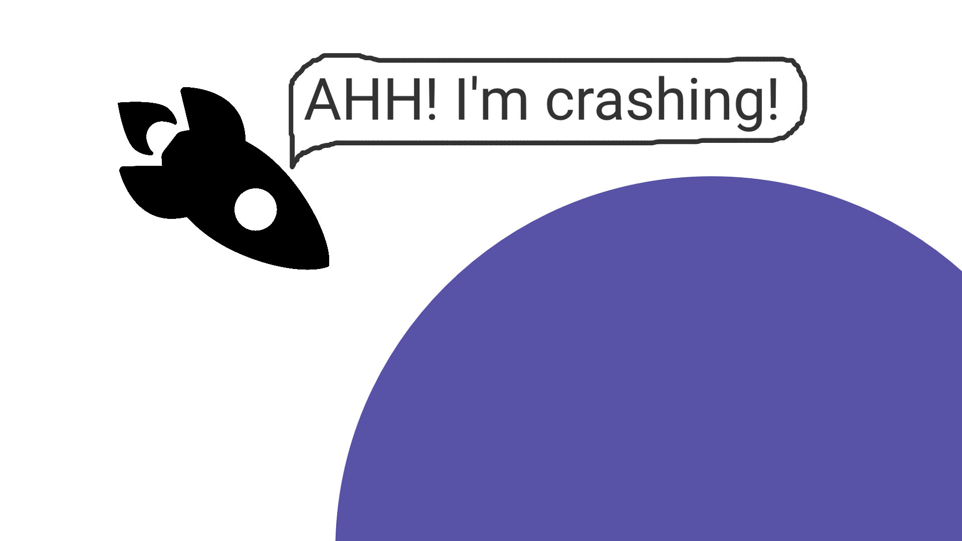
STORYBOARD
Start - Crash Land on Planet
This is the start of the game. The player will see a cut scene of a spaceship crash landing on a planet.

Slide 6
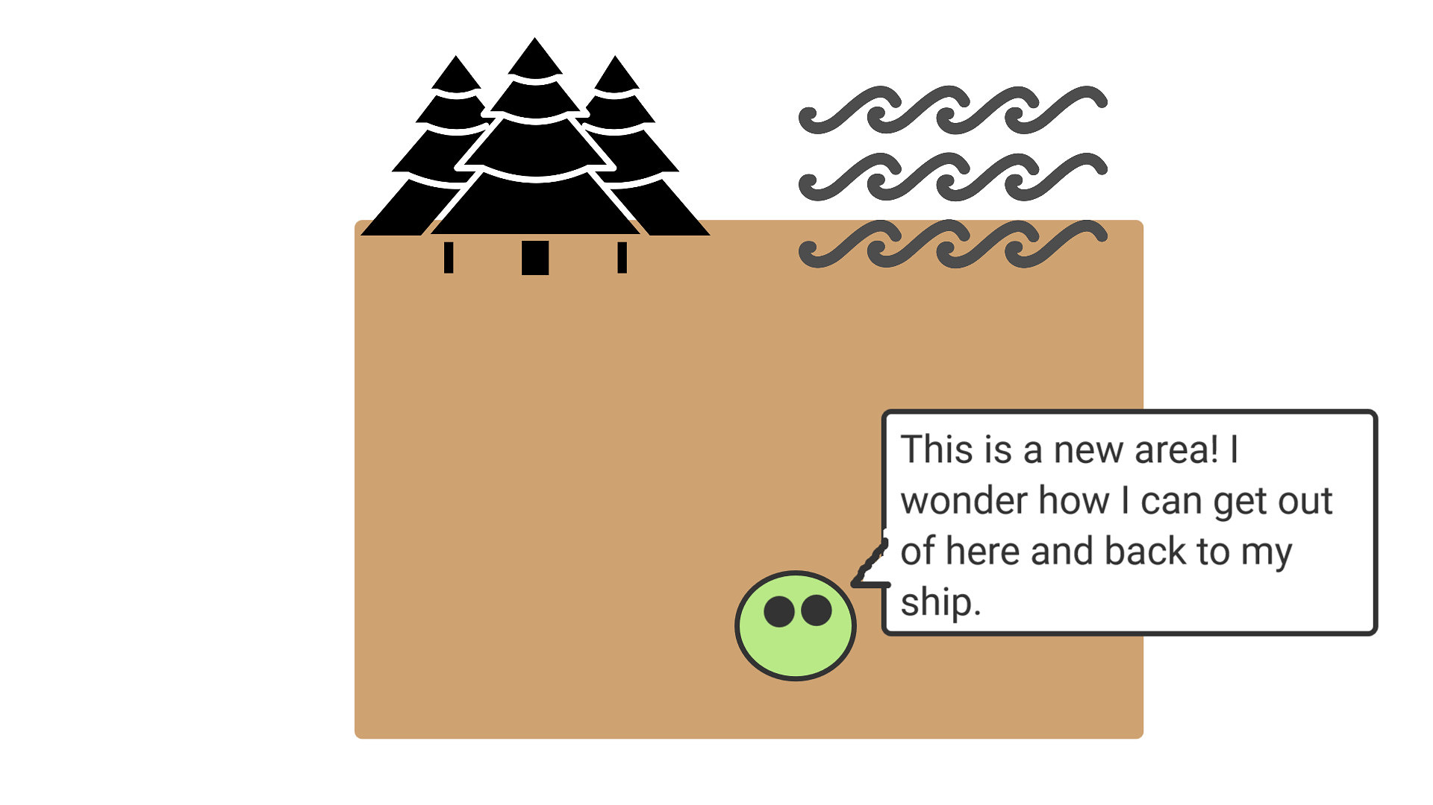
STORYBOARD
Entering a new biome
This is the start of a new area for the player to enter.
This is the beginning of the loop.

Slide 7
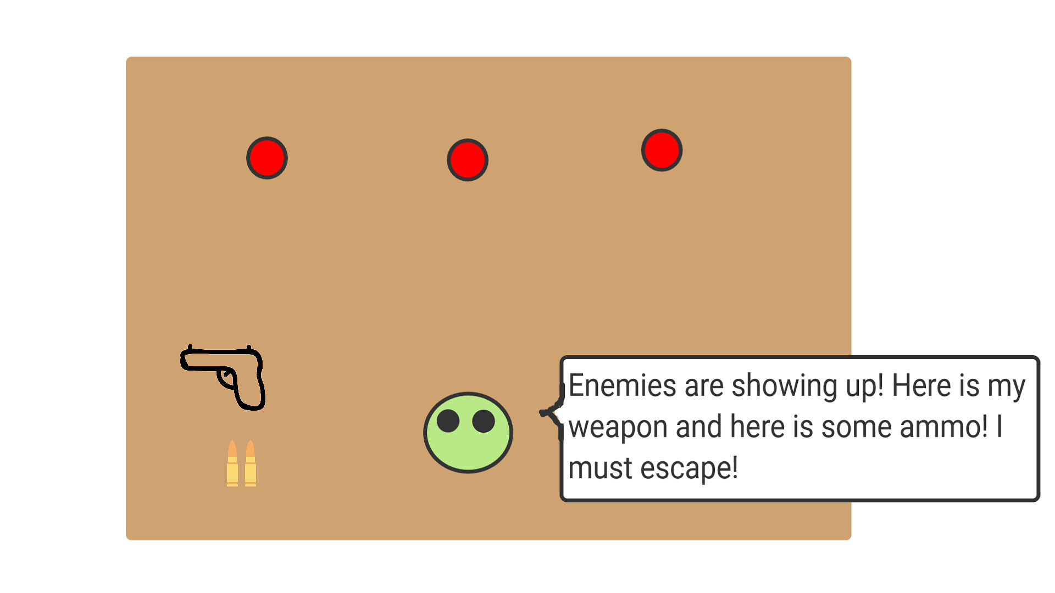
STORYBOARD
Battle through the room
Enemies start spawning, as well as a weapon and ammo. The player must defeat the enemies in order to escape and survive.

Slide 8
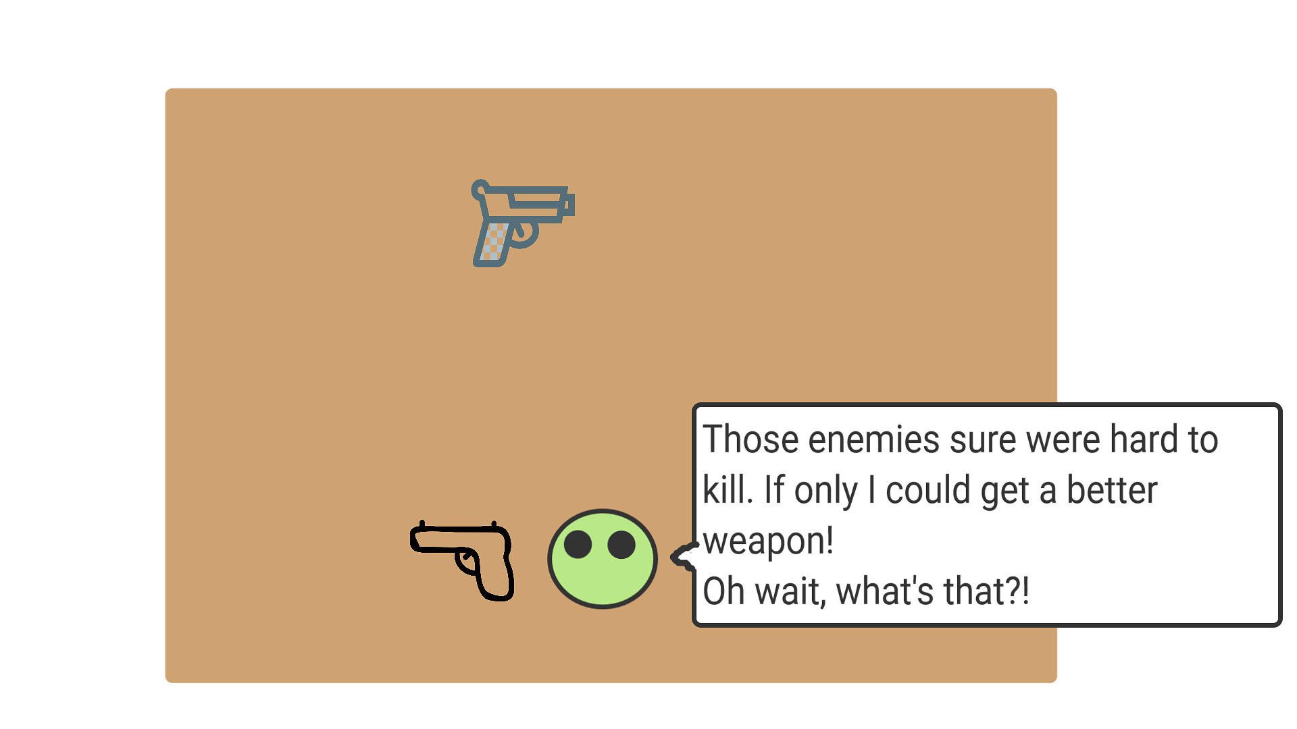
STORYBOARD
Get new weapon
Player is able to get a new, better weapon after defeating the enemies.

Slide 9
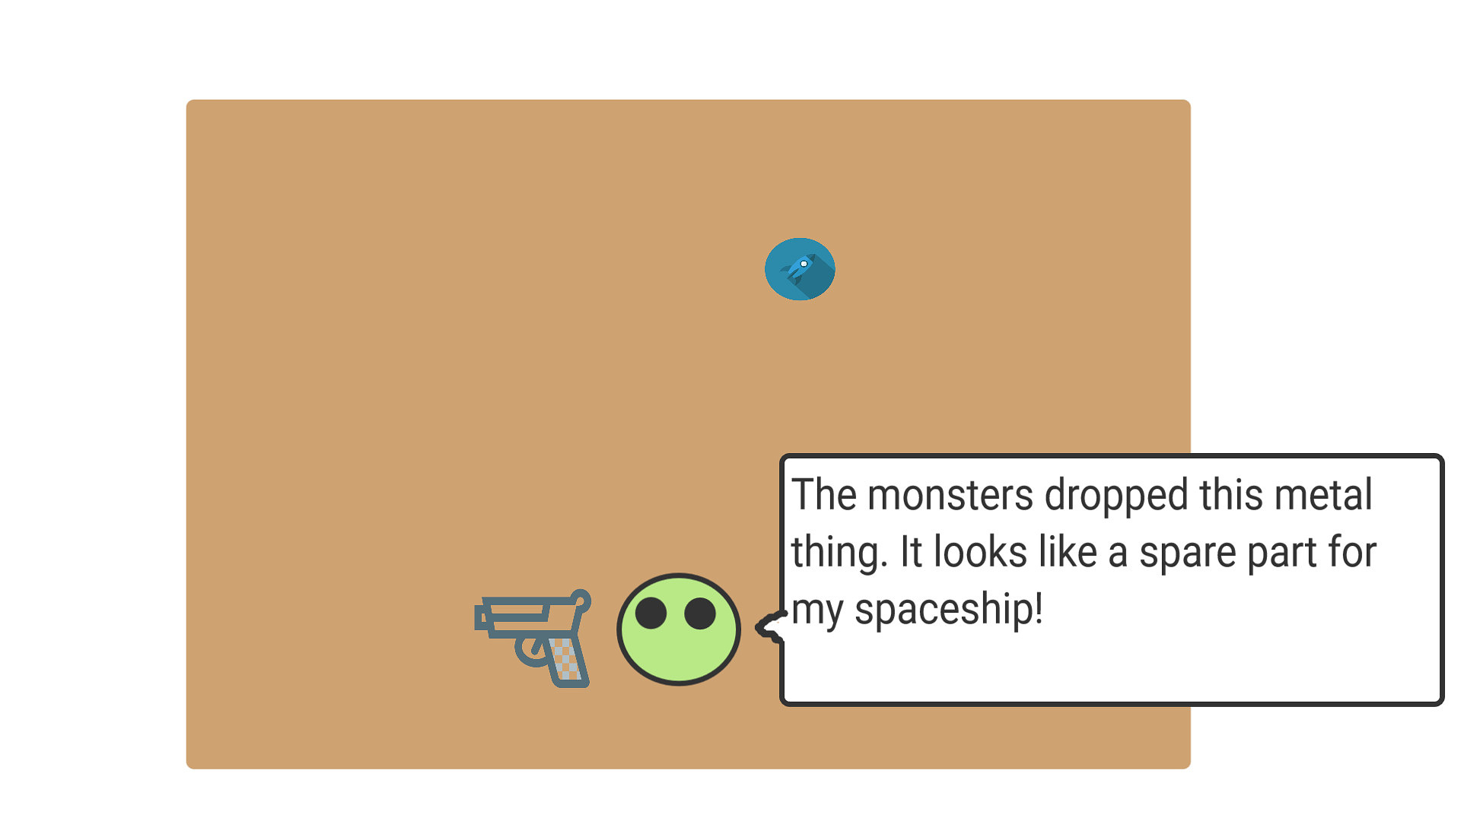
STORYBOARD
Get spare parts
The enemies will also drop a spare part for the spaceship. These will be required to fix the ship in order to leave.

Slide 10
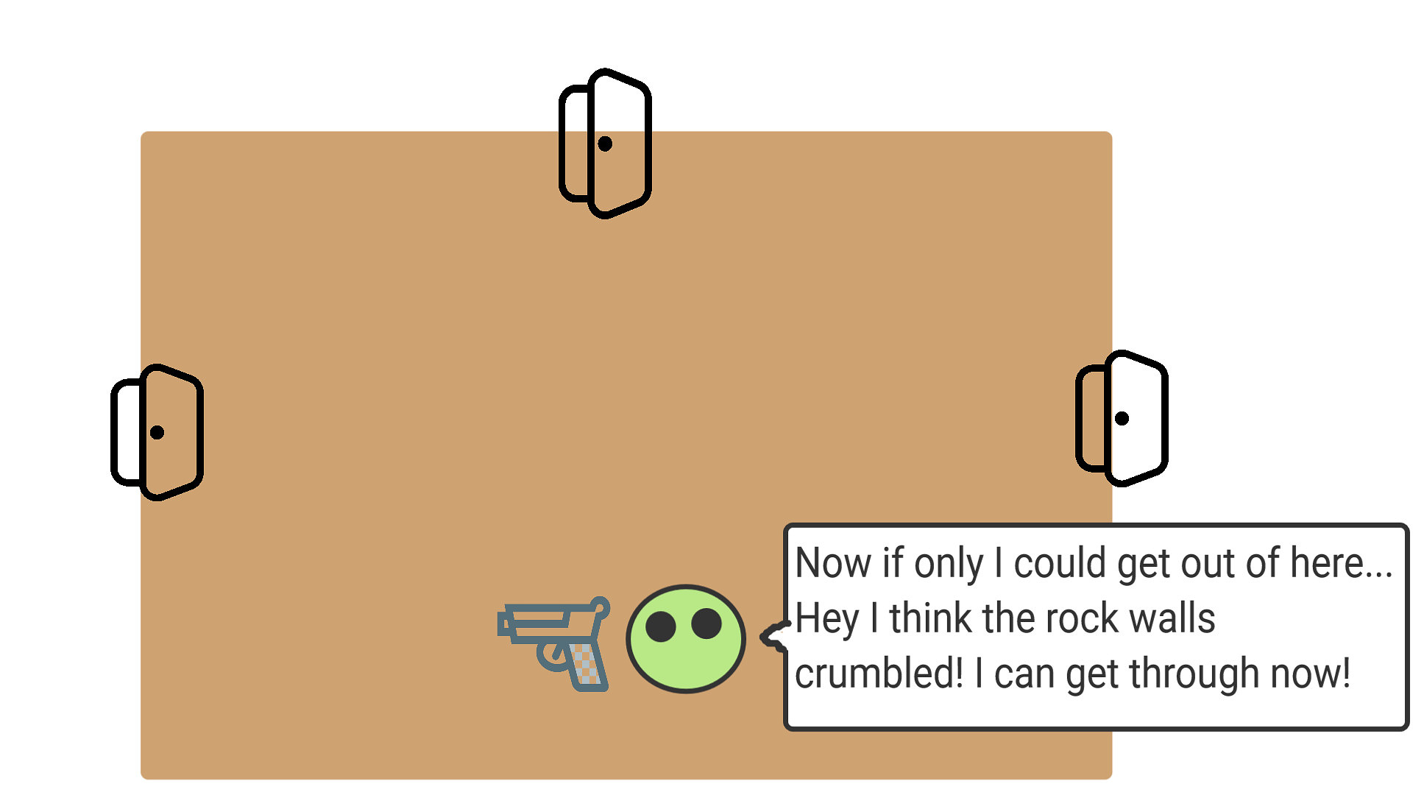
STORYBOARD
Leave Room
The player will then be able to leave the current area via 3 different exits.

Slide 11
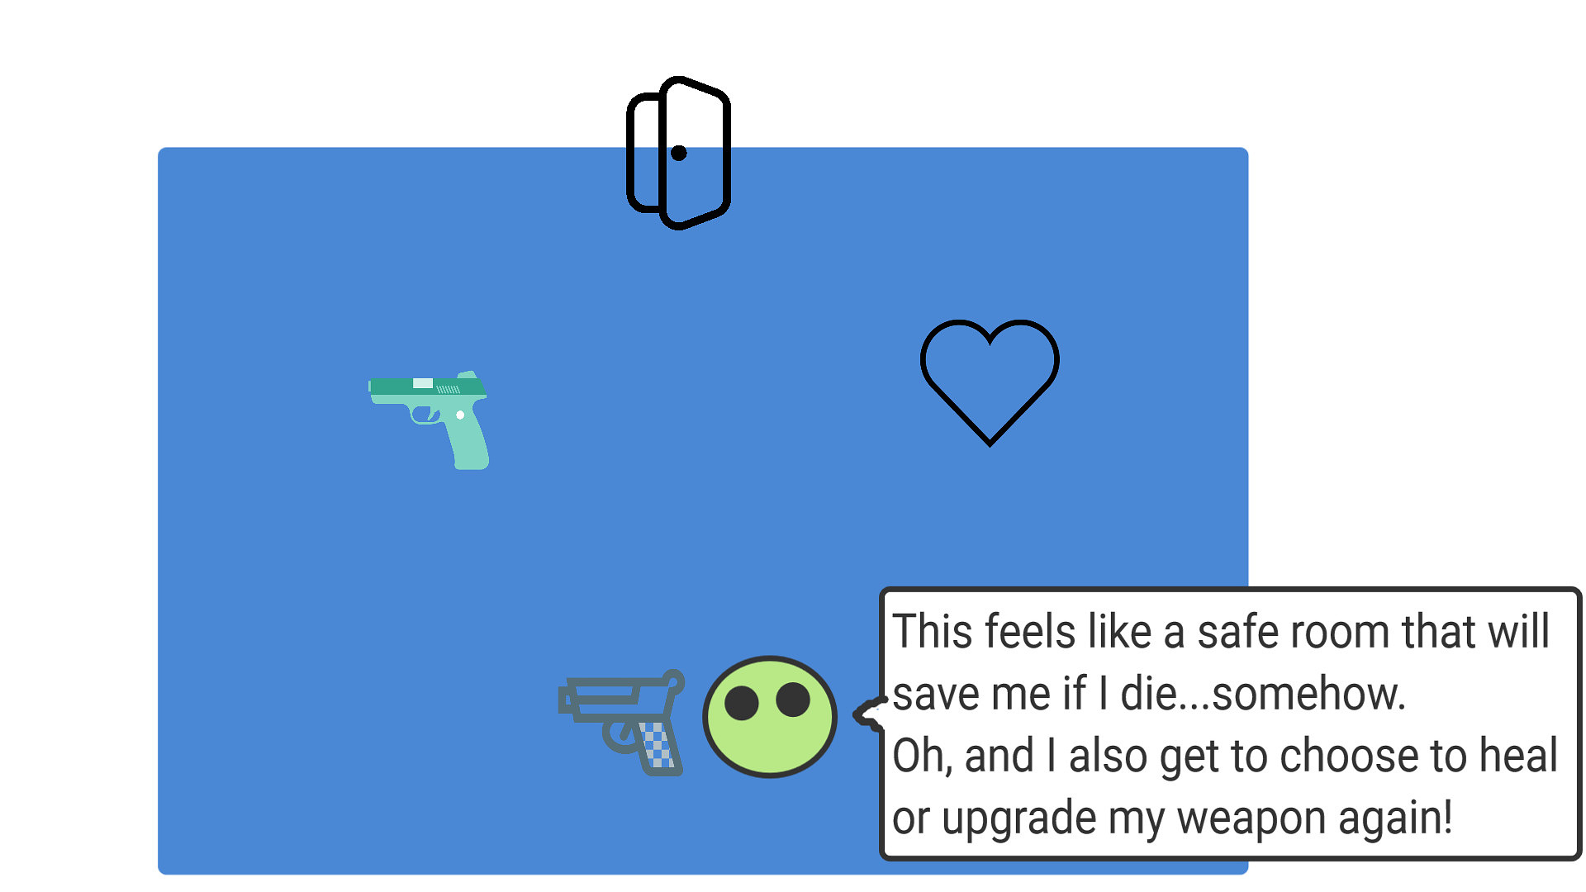
STORYBOARD
Checkpoint!
After so many rooms, the player will enter a checkpoint room. The purpose of this room is to create a save point.
The player will also be able to choose between a weapon upgrade, or being healed before continuing to the next room.
Loop!
Repeat enter new biome.

Slide 12
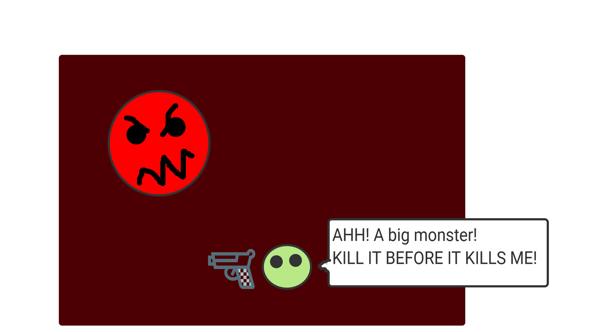
STORYBOARD
Boss Fight
After so many checkpoints, the player will encounter a boss monster.
Killing the boss is required to move on.

Slide 13
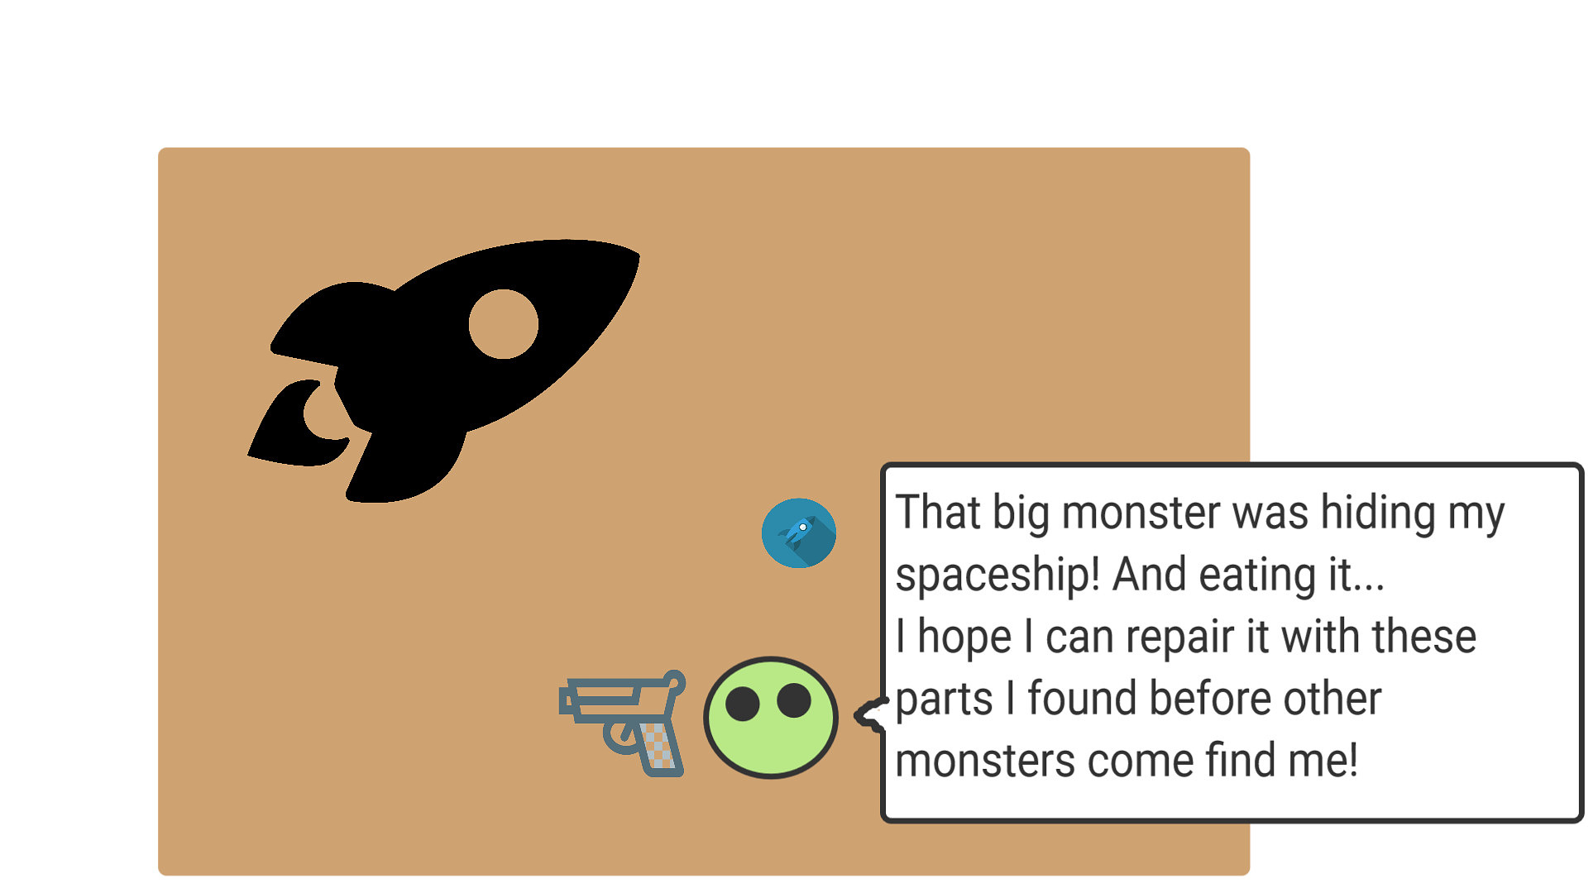
STORYBOARD
Finding the spaceship
The player will be able to find the spaceship and repair it.

Slide 14
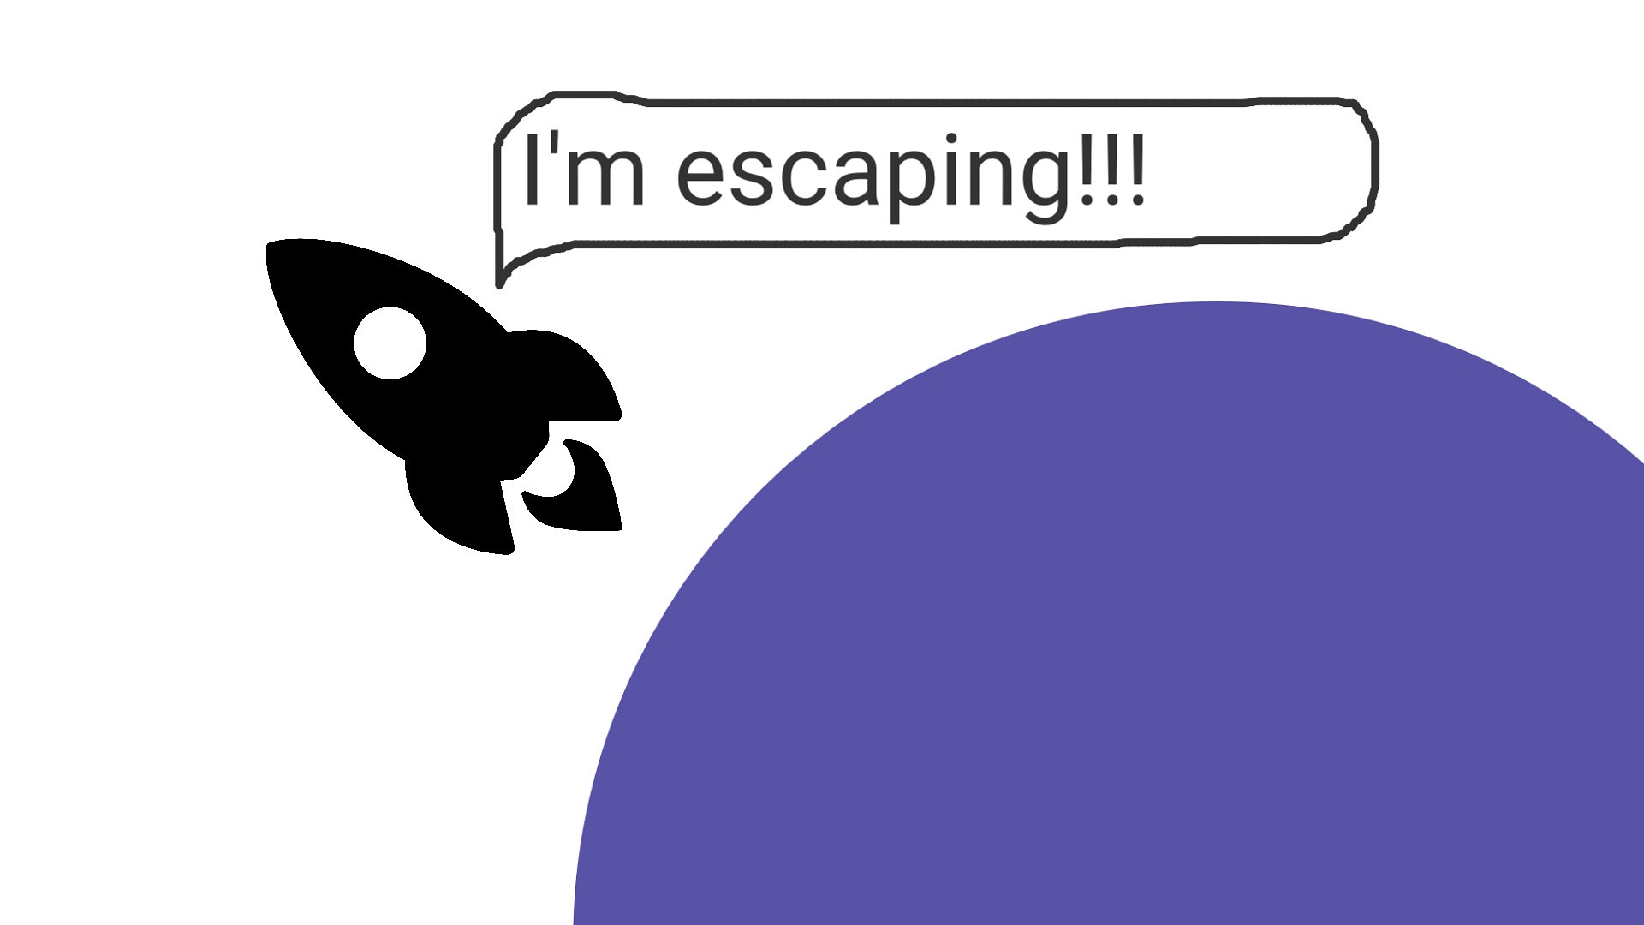
STORYBOARD
End - Leaving the planet
The end of the game is the player escaping from the death planet.

Slide 15
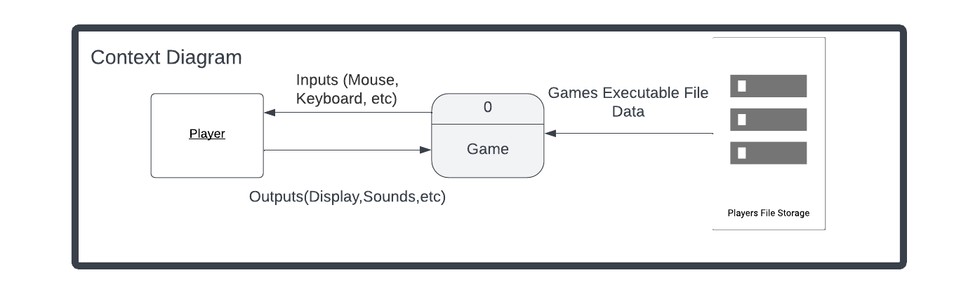
Context Diagram

Slide 16
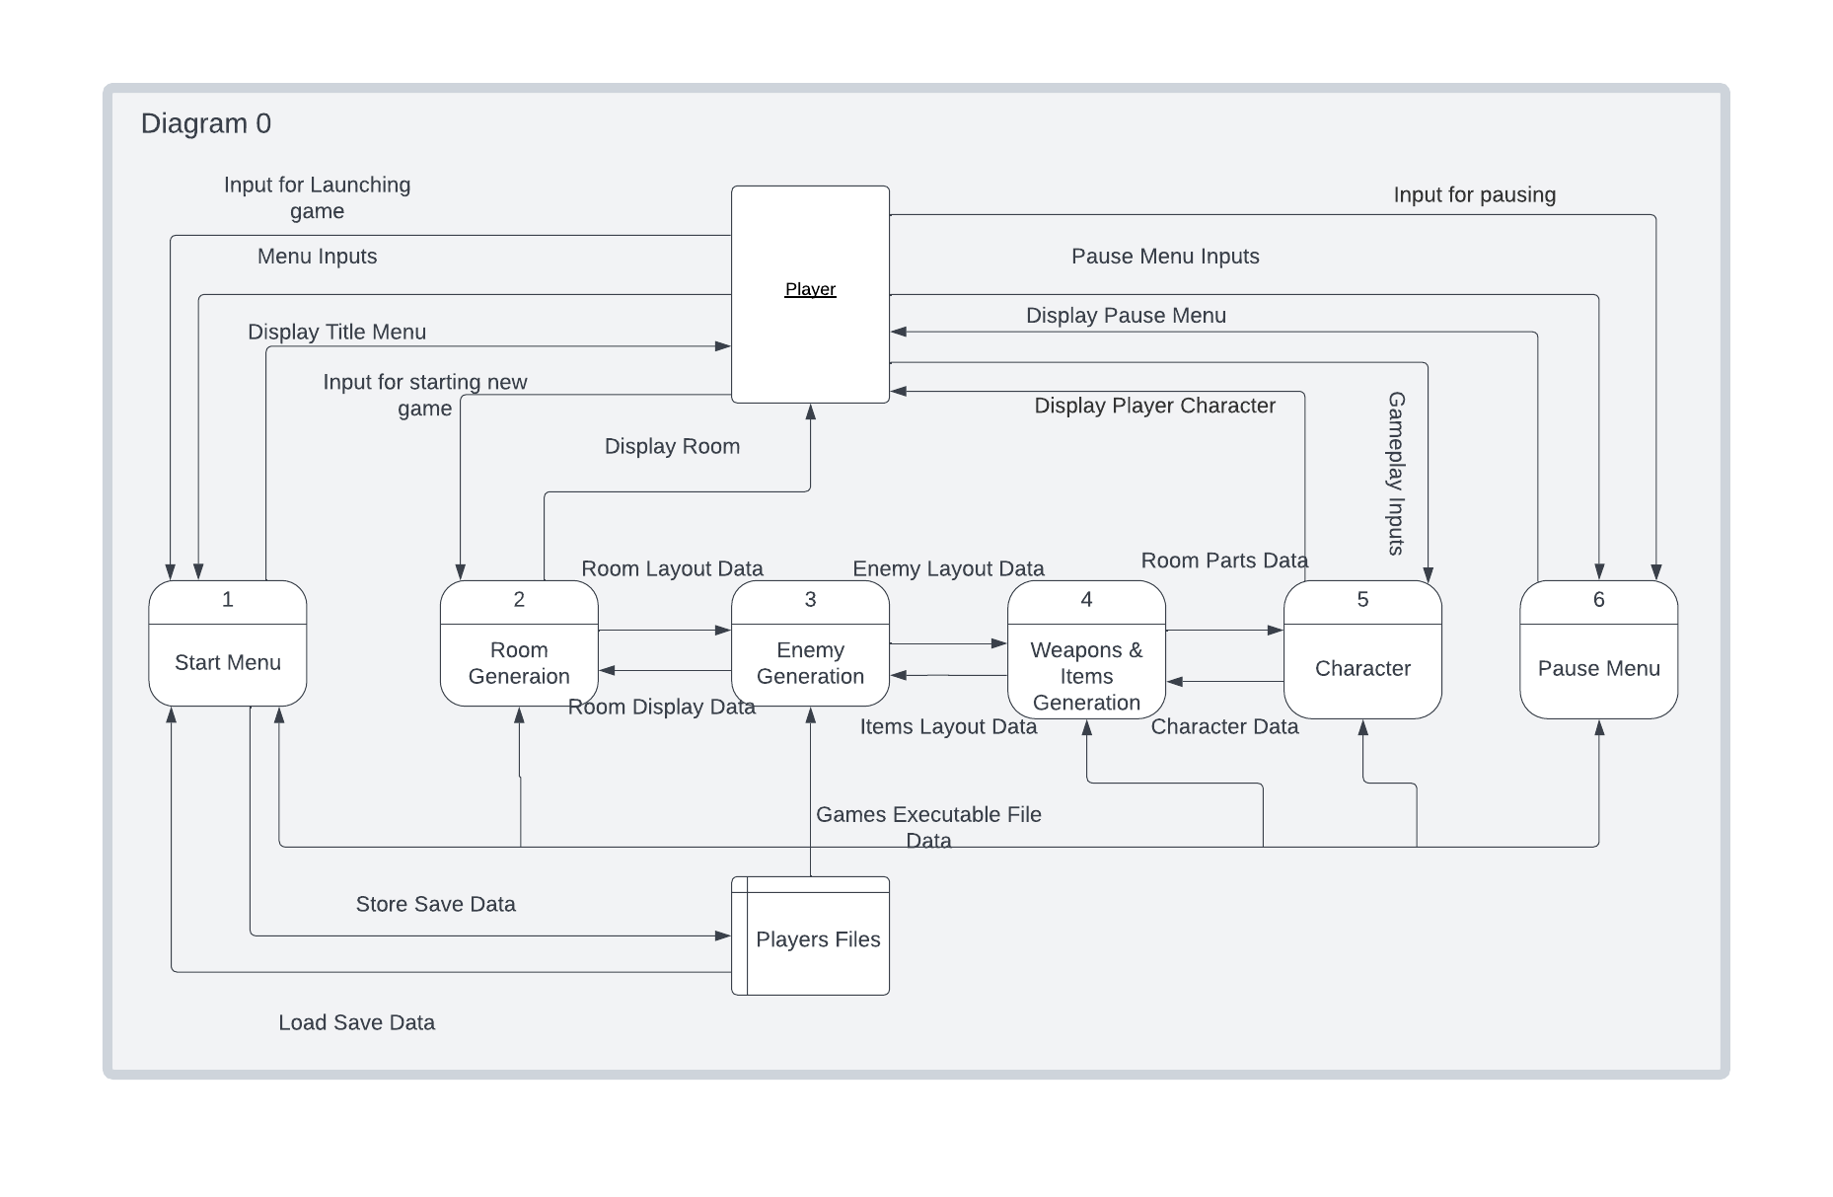
Diagram 0

Slide 17
Taylor Martin: Player and Enemies
My features for D.R.E.A.D are the Player and Enemies. Since D.R.E.A.D
Is a top down 2D shooter, the player will be restricted to two axes. The player will be able to move left, right, up, and down in the X-Y Plane. The player will also be able to shoot the equipped weapons they have and roll to dodge enemies and projectiles.
The enemies will be restricted to the same plane of movement as the player. The enemies will patrol, chase, search, and attack. There will be 3 main types of enemies: Auto Turrets, Light Enemies, and Heavy Enemies. Auto Turrets are stationary with low health, search for and shoot at the player. Light Enemies will be the most common, with medium health, medium speed, and ranged attacks. Heavy enemies are harder to kill and travel slower compared to light enemies.
My features are essential to have for this game, having a high priority. You can't have a game without gameplay, and that is where the player and enemies come in.
In comparison to the other features in D.R.E.A.D, the player and enemies are the second most complex, behind room generation. I think they will take the most time. I will get the bulk of the work done with the M.V.P as Team Lead 2.
TM 2

Slide 18
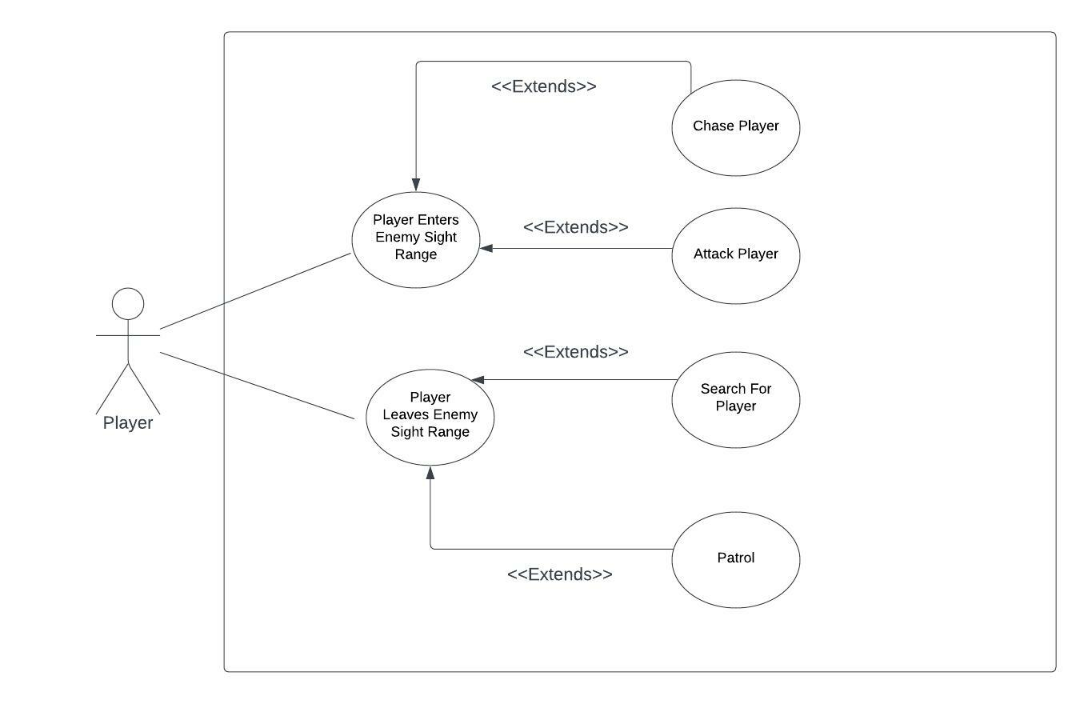
Enemy Use Case

Slide 19
Jordan Reed
Items, Weapons

Slide 20
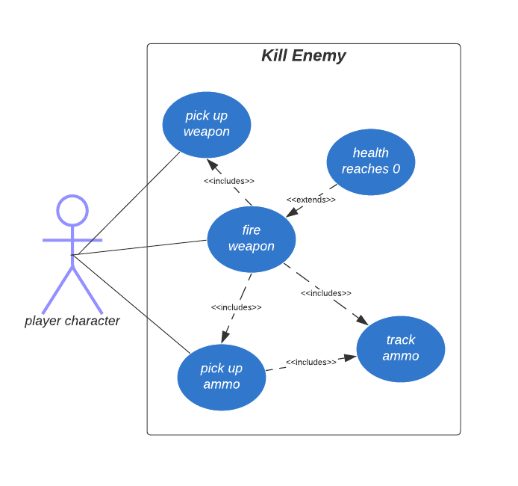
Weapon Use Case

Slide 21
Dan Blanchette
Audio Manager, Level Design
Feature: RNG Room Generator

Slide 22
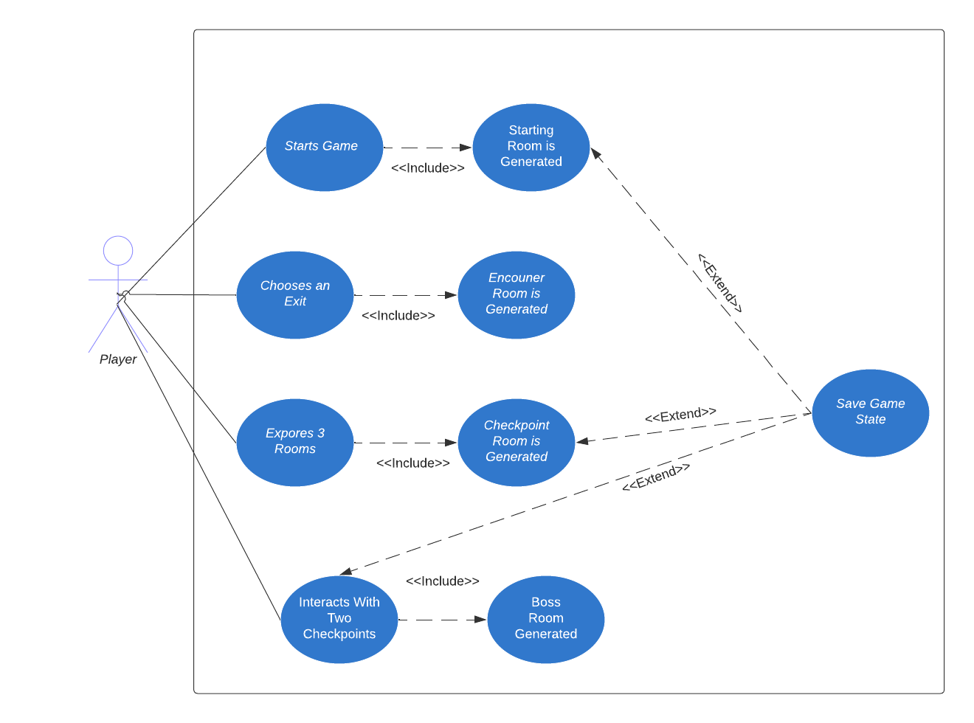
Room Generator Use Case

Slide 23

THANK YOU!
513 Studios

